Slide 1
Communication, Estimation & Negotiation
Rahul Mohandas

Slide 2
S1-25_SEZG509 Communication, Estimation & Negotiation
Session #7 – Sunday, 7 Sept 2025
Rahul Mohandas

Slide 3
Rumsfeld Matrix
Rumsfeld Matrix
Unknown Knowns
Unknown Unknowns
Known Knowns
Known Unknowns

Slide 4
Discussion Topics – Week 6
Communication: External Stakeholders
Engaging with customers
Engaging with partners (suppliers/ resellers)
Building positive external relationships

Slide 5
Discussion Topics – Week 7
Estimation: Value Estimation
The need for estimation
Dimensions of value
Market estimates – TAM/ SAM/ SOM
Value estimation risks

Slide 6
Some Scenarios
You need to:
Optimize a database query
Fix a memory leak that crashes servers intermittently
Implement automation test cases for a new feature
Migrate from an old API to a new authentication protocol
Build a deployment pipeline to reduce release cycles

Slide 7
Why Estimate?

Slide 8



Why Estimate?
Every Effort Is An Investment
Energy
Time
Money

Slide 9
When You Invest
Maximize ROI
Return = Estimated Benefits/ Value
Investment = Estimated Cost
Minimize Risk
…

Slide 10
3 Key Elements
How Much?
How Many?
How Likely?

Slide 11
How Much

Slide 12
Value Estimation
Functional
Emotional
Economic
Makes Money
Saves Money
Convenience
More Choice
How I Feel
How Others Feel

Slide 13
Slack - Example
Functional Value
??

Slide 14
Slack - Example
Functional Value
Less Email
Faster Responses
Finding relevant information
Fewer meetings
Economic Value
How much time does this save?
What is the average cost of this time?
How much would they be willing to pay for this saving?

Slide 15
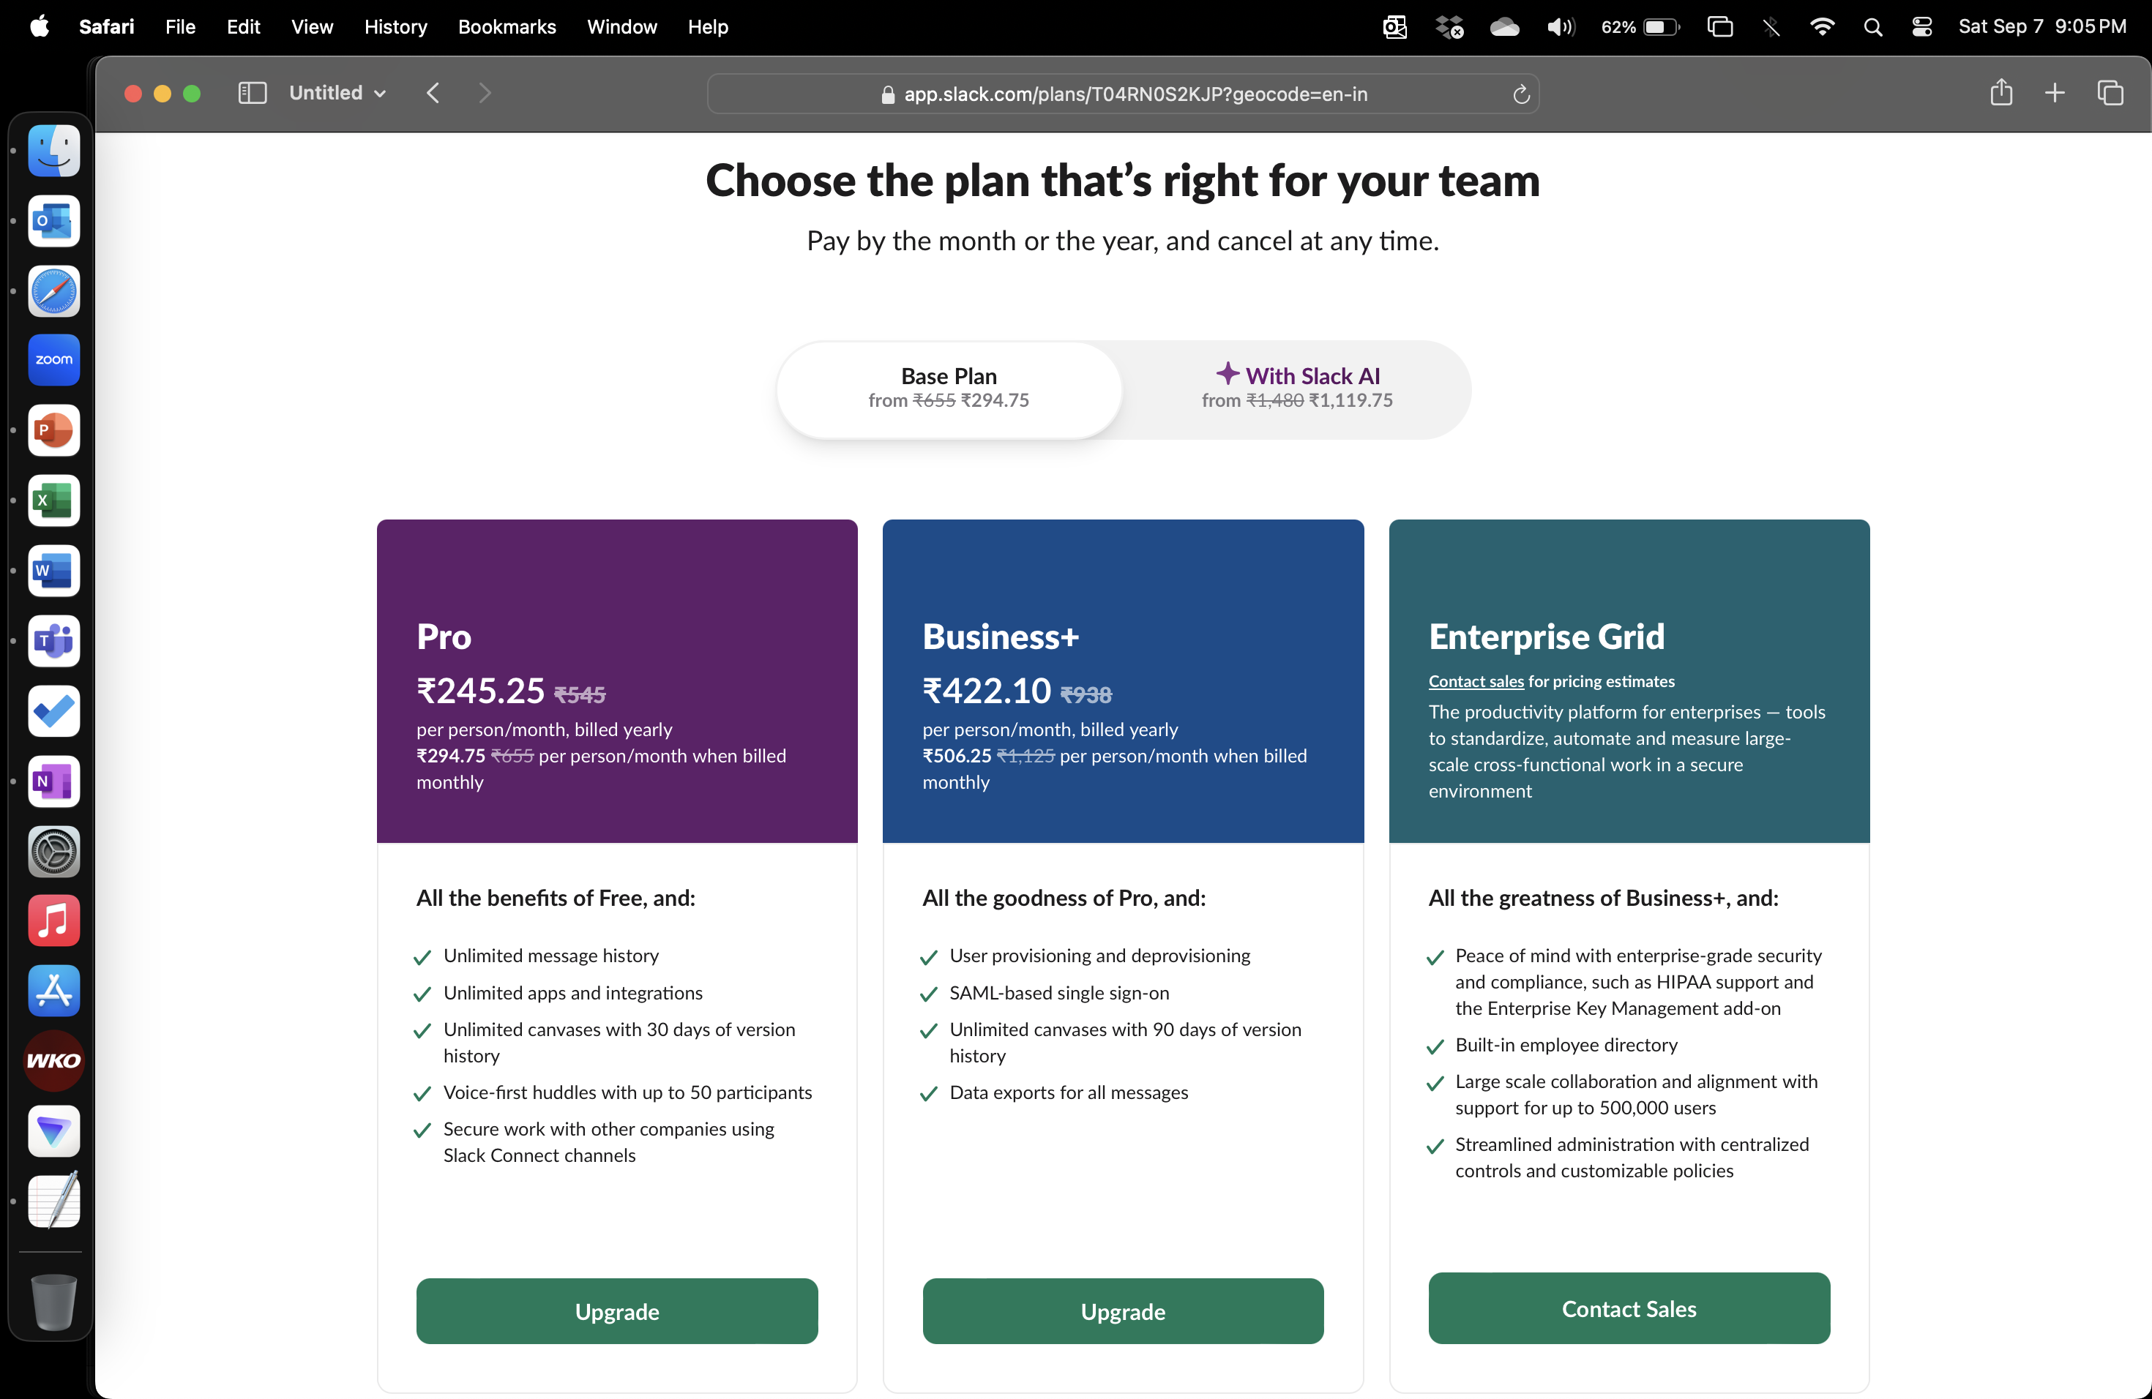
Slack Pricing

Slide 16
Reducing MTTR
Job Fails
Raise Ticket
Find Log
Root Cause
Rerun Job
Close Ticket
Fix Data Issue
3 days
0.5 hours

Slide 17
2 Negative Questions
What is the impact if we don’t do this?
What are we not doing, if we do this? What is the impact of not doing that?

Slide 18
SNCB Vs UK Rail
If you invest in SNCB what do you gain?
If you don’t invest in SNCB what do you stand to lose?
If we do SNCB, what will we not do?
UK Rail!
What do you stand to lose if you don’t do UK Rail?

Slide 19
How Many

Slide 20
TAM / SAM / SOM
TAM
SAM
Total Addressable Market
Serviceable Addressable Market
Serviceable Obtainable Market
SOM

Slide 21
TAM
TAM
SAM
Total Addressable Market
All Hospitals in the country
100k hospitals
SOM

Slide 22
SAM
TAM
SAM
Total Addressable Market
All Hospitals in the country
100k hospitals
Serviceable Addressable Market
Beds > 200
2.5k hospitals
SOM

Slide 23
SOM
TAM
SAM
Total Addressable Market
All Hospitals in the country
100k hospitals
Serviceable Addressable Market
Beds > 200
2.5k hospitals
Serviceable Obtainable Market
50 hospitals with over 200 beds in the State
SOM

Slide 24
TAM – Investor Perspective
10 investments – 1 will make it, 9 wont
The 1 that makes it should cover for the 9 that wont!
The 1 that makes it should be big enough!

Slide 25





Estimating Potential

Slide 26

Blue Tokai – New Outlet
In whitefield
Not in a high footfall area
Then Why???
Notes:
Food delivery orders
Coffee power orders

Slide 27
How Likely

Slide 28
Uncertainty
Uncertainty Factors
Customer behavior
Market conditions
Success rate
Cost estimates
…
Consider:
Historical data
Market research
Expert opinion
…

Slide 29
Probabilistic Model
Expected Value (EV) = ∑ (Probability of Outcome × Value of Outcome)
Example
40% chance of earning $100,000
60% chance of earning $60,000
EV = (0.4 * $100,000) + (0.6 * $60,000)
= $40,000 + $36,000 = $76,000

Slide 30
Activity

Slide 31
Some Scenarios
You need to:
Optimize a database query
Fix a memory leak that crashes servers intermittently
Implement automation test cases for a new feature
Migrate from an old API to a new authentication protocol
Build a deployment pipeline to reduce release cycles
Think of:
How will this make/ save money? Short term and/ or Long term?
How will it improve customer experience ?
How will it improve trust?
How will it reduce risk? What risk?
…

Slide 32
Value Estimation Risks

Slide 33
What Can Go Wrong?
Overestimate – Overconfidence/ Optimism
Ignoring unknowns
Reliable historic data
Pressure induced errors
Confirmation bias
Overly complicated models
Validating assumptions

Slide 34

Questions

